Slide 1
Plicker

Slide 2
What is it?
powerfully simple tool that lets teachers collect real-time formative assessment data without the need for student devices

Slide 3
Quick video:
https://www.youtube.com/watch?v=dMAX2EQnUXE

Slide 4
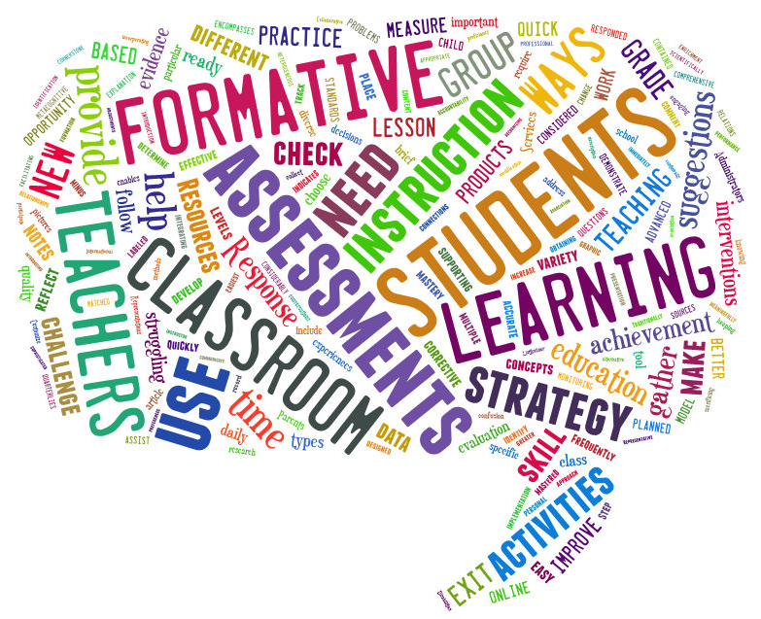
Curriculum and Teaching standards
“
T.S:6
Make accurate and productive use of assessment
”
accurately and are confident in checking the reasonableness of their answers to problems.”- Science
“answering and asking questions”- English
accurately and are confident in checking the reasonableness of their answers to problems. – Maths

Slide 5
Your turn ! think.. discuss..
What are the potential difficulties of using this in a classroom?
Are there any safety issues?
Are their any positives to using this in the classroom?
ALL
MOST
SOME
https://www.plickers.com/

Slide 6
What did you come up with?
Difficulties? | Positives? | Safety?

Slide 7
Positives
Children think of it like a game
Easy to use
Free
No need for (BYOT)
Automatic feedback
Class response system without requiring children to log on
Horizon report (J Bacon and B Ward, 2015)

Slide 8
Disadvantages?
Limited questioning
Plicker cards themselves
No differentiating
Time consuming
Common sense education review

Slide 9
Class room management
Easy to use, no fuss
Cards area linked to specific children
Set up time
Targeted questioning
Carpet spaces
“Cognitive and environmental influences are considered to be mediates influence of good behaviour”
Social behaviour in children (J. Matson, 2009)
Notes:
Cognitivism links closely to interacive assignments and can benift classroom behabour through givinf chidlren the time to reflect and problems solve at their own level of development.

Slide 10
E-safety
No need for children to have their own login no logging into apps
Children's first names are logged, but school and second name is not
Only data logged is their scores.

Slide 11
Would you use this in a class?
Listen to this clip of a teachers experience with Plickers?
Do you agree with her views?
Do you disagree ?
Why?

Slide 12
“The onus is on the teacher to make the questions rich enough to provoke critical thinking and deep learning.”
-education review

Slide 13
Any questions?

