Slide 1
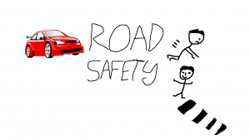
My E-Learning activity

Slide 2
Structure
My E-Learning activity
Why did I choose this topic?
How will I present this E-Learning activity?
How did I use the multimedia principles?
Notes:
I will first of all introduce my E-Learning activity, I will explain why I chose this particular topic for the activity and how I will present it, stating what tools/software I will use. I will go on to discuss which of the Multimedia Learning principles I used in this presentation and how I used them.

Slide 3
My E-Learning activity
Road safety
Target audience children aged 7-11 years old
Notes:
My E-Learning activity topic will be related to Road Safety. The target audience will be Primary school children aged 7-11 years old.

Slide 4
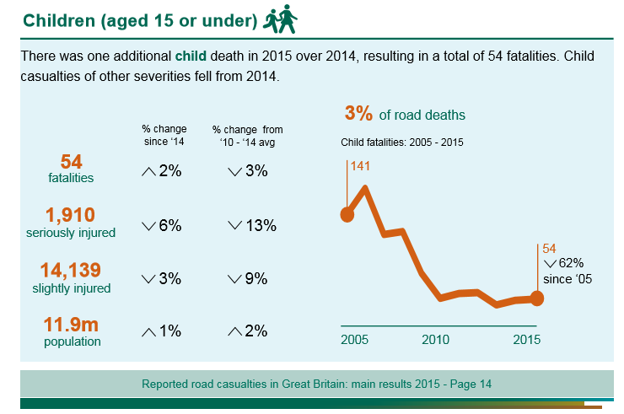
Why did I choose this topic?
Relevant life skill
Dependence -> independence
Dangers of not paying attention
Increasing traffic
Notes:
I have chosen activities relating to Road Safety because it is a relevant life skill to have and to gain. This is supported by the Constructivist theory which states that learning is contextual and therefore learn better when it relevant to them (Allsop, 2016). Many children, especially by the age 11+ will likely move from a stage in their life where they are dependent on their parents e.g. walking them to school to becoming more independent and walking to school themselves, with friends or via public transport. The road can also be a dangerous environment, not least when you are paying the least amount of attention, e.g., listening to music. In 2015 there were 54 fatalities of children 15 years and younger, a 2% increase from 2014. Although the percentage of slight and serious injuries has fallen 3% and 6% respectively the figure is still alarmingly high. (Department for Transport, 2016). 29% of incidents on the road involving child pedestrians happened between 3-5pm (Department for Transport, 2016). This suggests they are occurring whilst the child is on their way home from school. There has also been an increase in the amount of cars on the road which has meant that there has been a build-up of traffic.

Slide 5
How will I present this E-Learning activity?

Slide 6
padlet
Notes:
My first activity will be completed using Padlet. This is an online tool which supports children’s learning by enabling them to share their ideas and opinions on any topic. For my activity there will be a set discussion on the topic of Road safety, what they already know and do to stay safe. This activity supports a constructivist view of learning as the children will be encouraged to build upon prior knowledge. Social constructivism, Vygotsky’s Zone of Proximal Development links in with this particular activity as the learner’s actual developmental level and their potential developmental level can be enhanced through learning collaboratively with peers (Vygotsky, 1978)

Slide 7
Powtoon
Notes:
For my second activity I will create an animated video using Powtoon which highlights the many dangers the road poses for pedestrians. Powtoon is an on-line tool for creating animated videos/powerpoints. It supports learning through visual methods and engages children through the animated characters on screen and it is visually appealing.

Slide 8
scratch
Notes:
For my third activity I will create a game on the software Scratch. It is an on-line tool to create games. The game that I will create will involve the child controlling a character which must cross the road safely in different situations whilst there are vehicles driving along the road. This tool supports learning as it is interactive and encourages the child to take control of the character’s safety. It also supports the children’s learning by allowing them to develop their road safety skills in a safe environment. This interactive element of playing the game supports a Constructivist view of learning as the children are learning by taking an active part, children construct new knowledge about the physical and social worlds in which they live through playful objects. (Piaget, 1969)

Slide 9
kahoot
Notes:
The last activity will be a Quiz, created using Kahoot. This will test the children’s memory and knowledge of what they have learned regarding Road safety. Kahoot can be used as a constructivist form of assessment, Virtual Learning Environment as it enables the teacher to view the children’s answers instantly and monitor their progress as well as providing instant feedback for the children (Allsop, 2016). It can identify areas where there may be gaps in their knowledge which provides opportunity to consolidate learning.

Slide 10
How did I use the multimedia principles?
Coherence Principle
Signalling Principle
Spatial Contiguity Principle
Temporal Contiguity Principle
Multimedia Principle
Personalization Principle
Voice Principle
Notes:
The multimedia principles as stated by Mayer, 2001 which I have used are as follows:
I have used the Signalling Principle by including an introduction slide to identify what I will talk about in each slide. I have also included a heading for each slide to remind the audience what will be discussed.
I have used the Coherence Principle by only writing key points on each slide and keeping images per slide to a minimum.
I have used the Spatial Contiguity Principle by presenting pictures relevant to the text in close proximity to each other on each slide.
I have used the Temporal Contiguity Principle by ensuring that relevant text and pictures appear on the screen together on each slide.
I have used the Multimedia Principle. Where appropriate I have included relevant pictures along with the text on the slide.
I have used the Personalization Principle by presenting without using too much formal language, where I have, I have explained what the terms mean.
Finally, I have used the Voice Principle as I have narrated this entire presentation without any electronic voice support

Slide 11
bIBLIOGRAPHY
Allsop, Y. (2016). Does technology improve learning – the value of constructivist approaches to technology-based learning. Available: http://www.ictinpractice.com/does-technology-improve-learning-the-value-of-constructivist-approaches-to-technology-based-learning/. Last accessed 3rd December 2016.
Department for Transport. (2016). Reported road casualties in Great Britain: main results 2015. Available: https://www.gov.uk/government/statistics/reported-road-casualties-in-great-britain-main-results-2015. Last accessed 3rd December 2016.
Mayer, R (2001). Multimedia Learning. Cambridge: Cambridge University Press. p81-147.
Piaget, J. and Inhelder, B., 1969. The psychology of the child. Basic books.
Vygotsky, L. (1978). Interaction between learning and development. Mind and Society. 1 (1), p79.

Slide 12
THANK YOU FOR LISTENING

