Slide 1
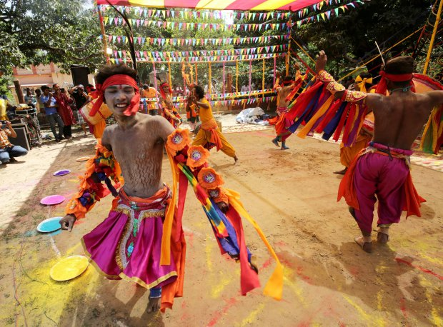
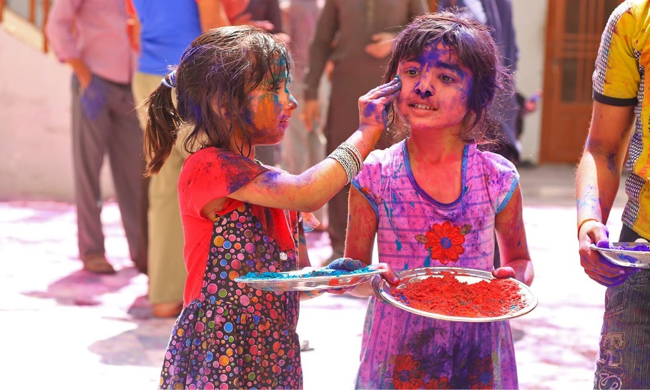
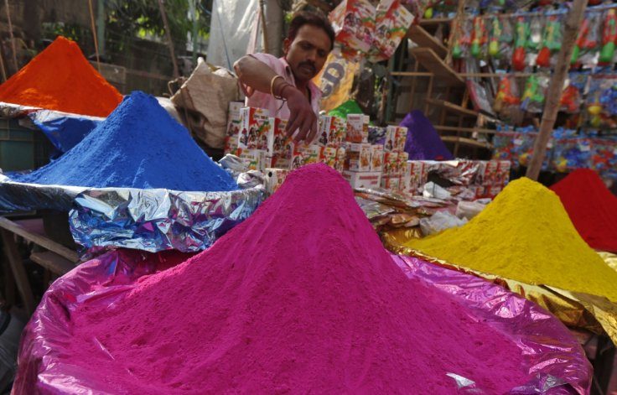
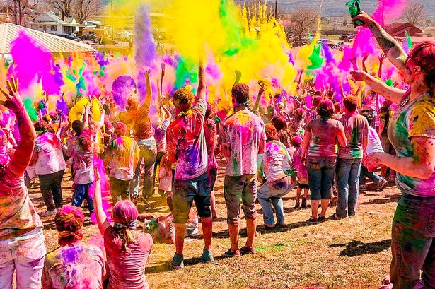
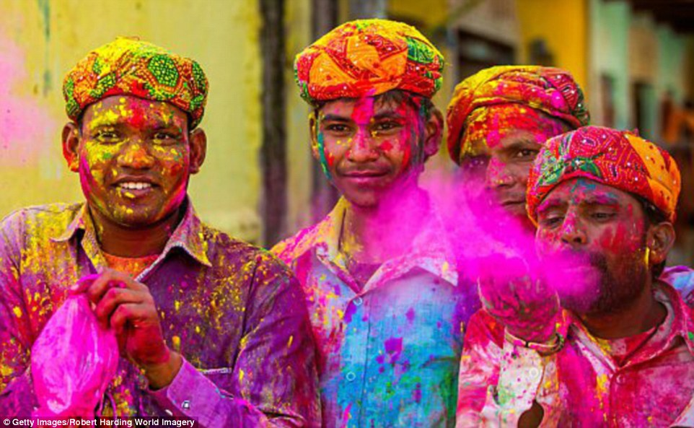
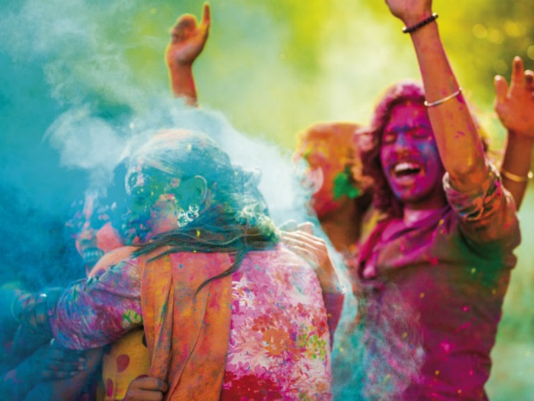
Pick an image and describe it.
Explain what it shows – where it could be, who is in it and what emotions does it evoke?
Notes:
Starter
What are we looking at today?
Lead in to discussion

Slide 2
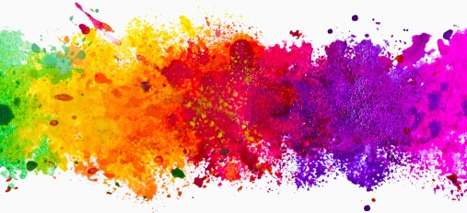
Holi
LO: To examine the Hindu festival of Holi and how it links to Hindu teachings.
A Hindu spring festival celebrated in February or March – Holi Festival is celebrated on the Phalguna Purnima – full moon
People are brought together to play and laugh, forget and forgive, to repair ruptured relationships.
It is celebrated across the world by people of different or no faith
Holi
The festival signifies the victory of good over evil, the arrival of spring and the end of winter, and an opportunity to meet others.
The many themes of the festival: renewal, companionship and the triumph of good, is found with variations all over India.
The festival lasts 2 days
Notes:
Can you think of another festival celebrated in this way?
A spring festival, usually celebrated in March
Holi also celebrates Krishna, and the legend of Holika and Prahalad
Holi is particularly celebrated in North India
Although Holi has religious roots there are few religious things to do
Distinctions of caste, class, age, and gender are suspended during Holi
A very exuberant festival, with dancing, singing, and throwing of paint
Holi features gender rivalry, with contests between men and women, and public flirting
Bonfires are lit during Holi, and food offerings are roasted
The festival is officially celebrated on the day after full moon during the month of Phalunga, which falls in February-March
Holi is a great leveller.
During Holi celebrations in India it's possible to behave pretty outrageously.
Gulal is powdered colour, and Indian streets are bright with stalls selling powders of different colours for days before the festival.

Slide 3
LO: To examine the Hindu festival of Holi and how it links to Hindu teachings.
Summarise in your books the stories that are expressed through Holi.
Make sure you understand the stories and write clear notes.
Stretch: Does a festival lose its meaning if it is celebrated by people of all faiths?
Notes:
Talk about the legend
Krishna and Radha – colour and love story
Prahlad – worship – sister Holika co-ersed him to sit on her lap in the bonfire. Because the trick was played using evil – it did not work and she burned.
A pyre, also known as a funeral pyre, is a structure, usually made of wood, for burning a body as part of a funeral rite or execution. As a form of cremation, a body is placed upon or under the pyre, which is then set on fire.
Gopi - Milkmaid

Slide 4
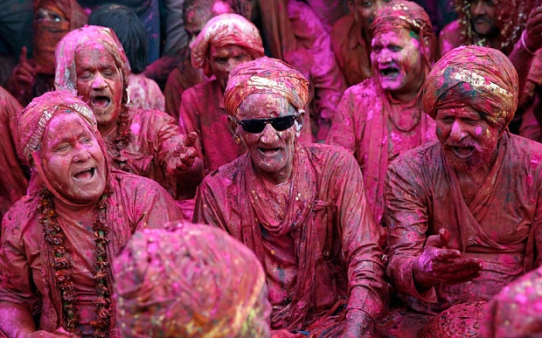
Holi
Holi
LO: To examine the Hindu festival of Holi and how it links to Hindu teachings.
Notes:
https://www.youtube.com/watch?v=AbFIkJ8KFZ8
India
Video – 1.32mins
Students to watch
http://www.thedrum.com/news/2018/03/05/pharrell-williams-celebrates-holi-festival-with-ranveer-singh-adidas-originals
Pharrell Williams celebrates Holi festival with Ranveer Singh for Adidas Originals - Williams' 'Powder Dye' capsule collection for Adidas Originals follows on from his 'Hu Holi Adicolor' and 'Hu Holi Blank Canvas' ranges.
In line with the campaign, Adidas Originals has also rolled out a film explaining the festival of Holi which shows people discussing the significance of the event's colours.
This year – March 1st 2018 – Bonfire
March 2nd 2018 – paint throwing

Slide 5
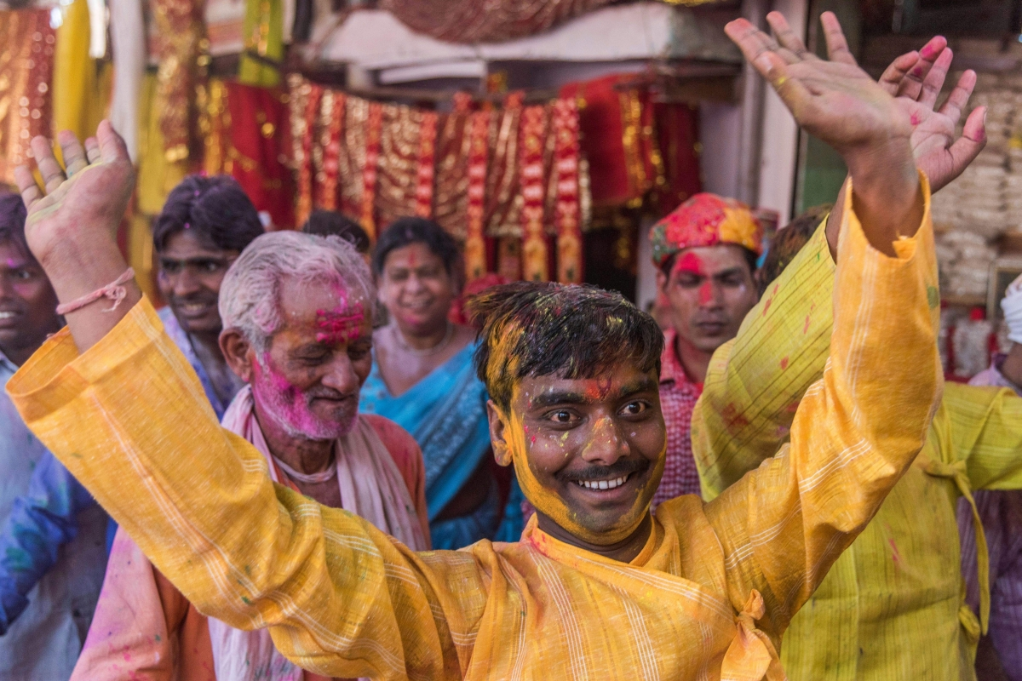
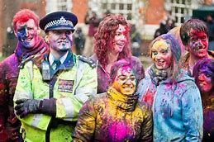
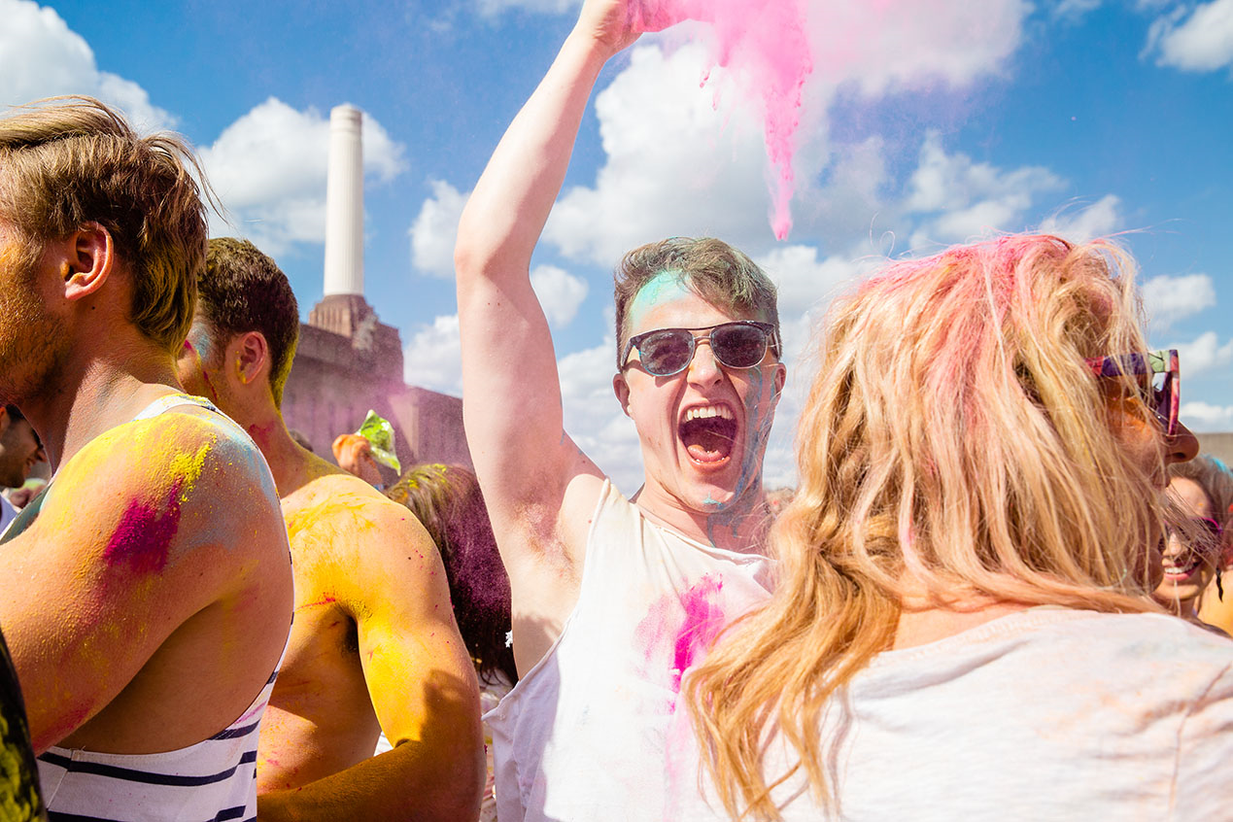
LO: To examine the Hindu festival of Holi and how it links to Hindu teachings.
Explain the differences between the way in which Holi is celebrated in the UK and India?
Notes:
London
https://www.youtube.com/watch?v=Ga-qqGv2k2w
Students to answer:
What are the differences between the way in which Holi is celebrated in the UK and India?
Timed question - 5mins
It is believed that Lord Krishna was sad over his dark complexion and wondered why 'Radha' was so fair. One day, his mother Yashoda playfully suggested that he can smear colour on Radha's face and change her complexion to any colour he wanted. Fascinated by the idea, Krishna proceeded to do so and thus, introduced the festival of colours. "Lord Krishna is believed to have popularised the festival by playing pranks on the 'gopis’.

Slide 6
Hindu teachings:
Some believe the origin of the festival lies with Krishna who was very mischievous as a young boy and threw coloured water over the gopis (milkmaids) This developed into the practical jokes and games of Holi.
The story of Prahlad is seen to symbolise good overcoming evil and is why traditionally bonfires are lit at Holi.
Prahlad was a prince. His father, the king wanted everyone in his kingdom to worship him. But Prahlad refused and worshipped Lord Vishnu instead. The king's sister Holika, who was supposed to be immune to fire, tricked her nephew Prahlad into sitting on her lap in a bonfire in order to destroy him. But because she was using her powers for evil, the plan failed and Prahlad emerged from the fire unharmed, while Holika was devoured by the flames.
In some parts of India effigies of Holika are burnt on the fire. Ashes from Holi bonfires are thought to bring good luck.
Notes:
Information for clarification

Slide 7
LO: To examine the Hindu festival of Holi and how it links to Hindu teachings.
Celebrations:
Bonfires are lit and roasting grains, pop corn, coconut and chick peas are thrown on by Hindu families
The next day, people of all ages go into the streets for fun and paint-throwing – powder paint called ‘Gulal’
Everyone gets involved - with no distinctions between caste, class, age or gender.
Hindus have fun by smearing each other with paint and throwing coloured water at each other, all done in a spirit of celebration.
There is dancing and singing - Holi songs are sung and the Dholak drums are played
How do the practices during Holy link back to Hindu teaching?
Notes:
Information for clarificationHoli also celebrates Krishna, and the legend of Holika and Prahlad.
Some believe the origin of the festival lies with Krishna who was very mischievous as a young boy and threw coloured water over the gopis (milkmaids) This developed into the practical jokes and games of Holi.
The story of Prahlad is seen to symbolise good overcoming evil and is why traditionally bonfires are lit at Holi.
Prahlad was a prince. His father, the king wanted everyone in his kingdom to worship him. But Prahlad refused and worshipped Lord Vishnu instead. The king's sister Holika, who was supposed to be immune to fire, tricked her nephew Prahlad into sitting on her lap in a bonfire in order to destroy him. But because she was using her powers for evil, the plan failed and Prahlad emerged from the fire unharmed, while Holika was devoured by the flames.
In some parts of India effigies of Holika are burnt on the fire. Ashes from Holi bonfires are thought to bring good luck.

Slide 8
How do the practices during Holi link back to Hindu teaching?
In India
In the UK
Holi
How do the celebrations link to Hindu teaching?
Krishna
Prahlad

Slide 9
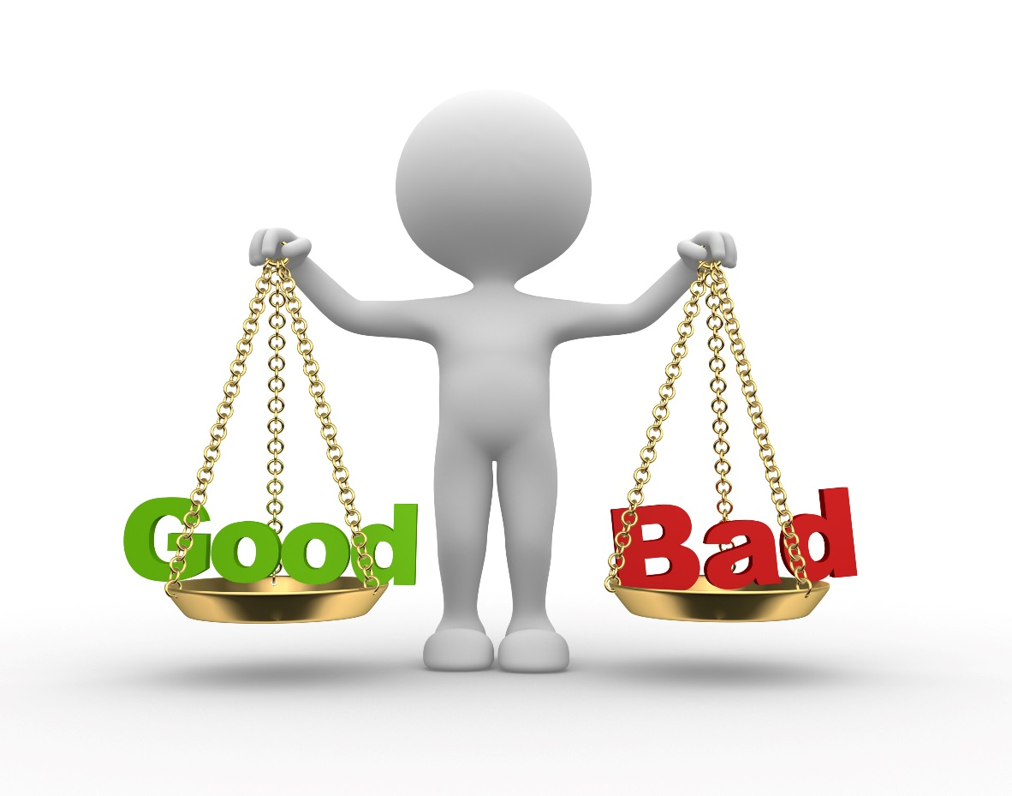
‘Hindu festivals are really social celebrations rather than religious occasions’ (15)
You are required to give an overall assessment of value with a justification of conclusions or viewpoints:
Strengths of statement:
*
*
*
*
*
Weaknesses of statement:
*
*
*
*
*

Slide 10
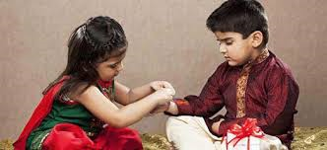
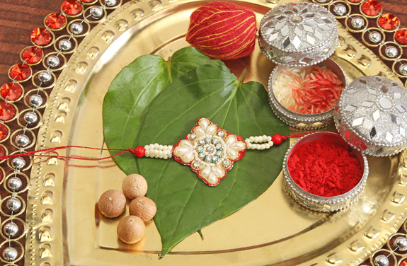
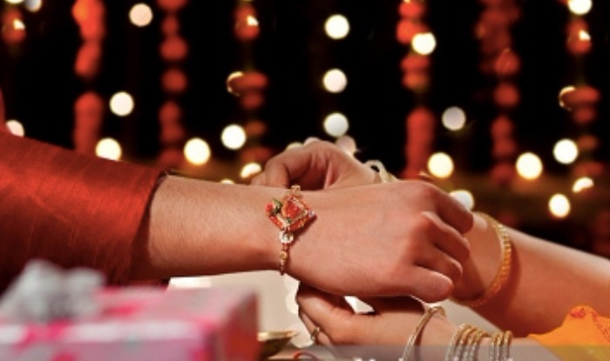
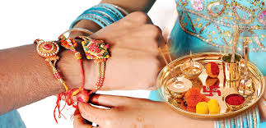
Raksha Bandan
Where?
When?
Why
Notes:
Plenary – to recap their homework and ensure they have notes about this festival in their books too.
Really popular in the UK – strengthens bonds with families in India
Gifts are sent in the post
26 Aug 2018
What did you find out about the Hindu festival Raksha Bandhan, also abbreviated to Rakhi, is the Hindu festival that celebrates brotherhood and love. It is celebrated on the full moon in the month of Sravana in the lunar calendar.
The word Raksha means protection, whilst Bandhan is the verb to tie. Traditionally, during the festival sisters tie a rakhi, a bracelet made of interwoven red and gold threads, around their brothers' wrists to celebrate their relationship.
Today the festival has developed with others joining in the festivities:
Priests tie rakhis around the wrists of congregation members.
Rakhis are often shared between close friends.
Women tie rakhis around the wrists of the prime minister.
Rakhis are tied around the wrists of soldiers.

