Slide 1
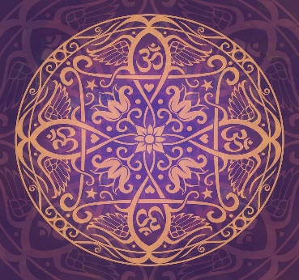
In India
In the UK
Holi
How do the celebrations link to Hindu teaching?
Krishna
Prahlad
Copy this diagram and complete with reference to your work from last lesson – you have 4minutes

Slide 2
LO: To understand the role of pilgrimage and the purposes and practices associated with pilgrimage for Hindus
Hindu Pilgrimage
Good
Explain, in a paragraph, what you think the term pilgrimage means.
Better
Explain the concept of pilgrimage using specific examples in your answer.
What is pilgrimage?
Best
Explain why pilgrimage is an important part of worship and reverence to God.
Notes:
Pilgrimage can be defined as a visit to a place of religious significance for a believer.

Slide 3
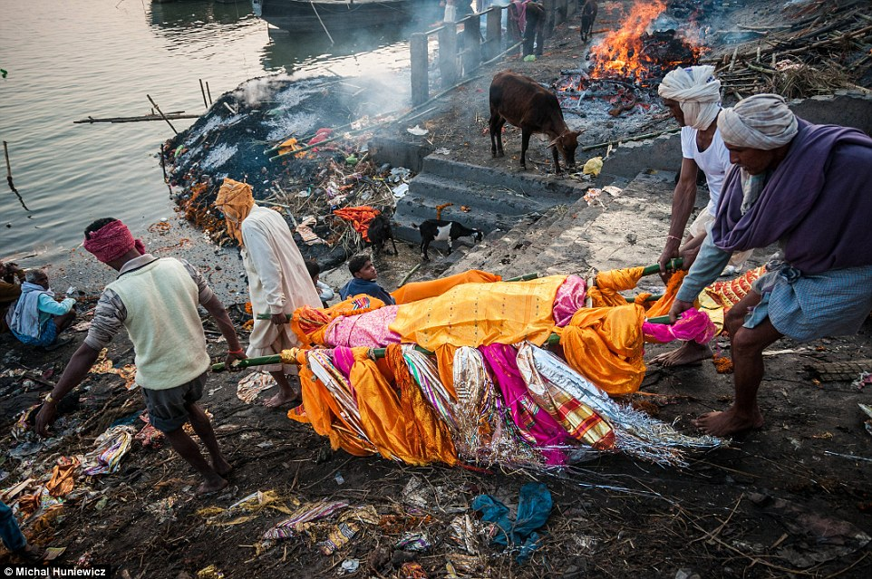
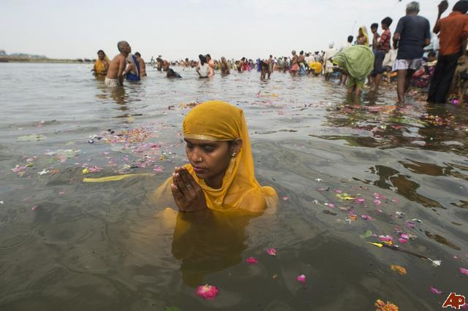
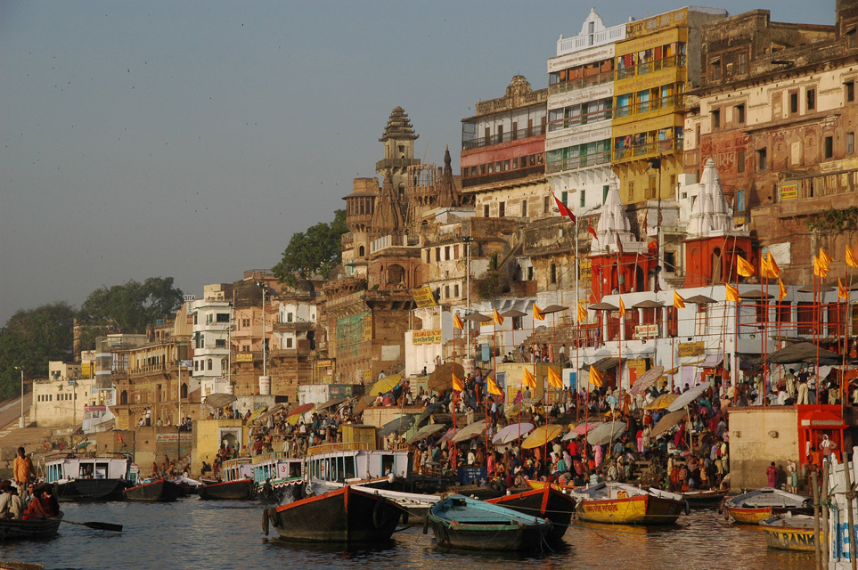
LO: To understand the role of pilgrimage and the purposes and practices associated with pilgrimage for Hindus
Make clear notes from the video and be able to explain the meaning of:
Ghats
Pilgrimage
Varanasi
In a paragraph, explain the importance of Varanasi for Hindus
Notes:
I wanted to show a video of Varanasi
This is the real Varanasi
Video clip – needs a warning with it – images of burning and cremation
Video clip – 7mins total
27.30 – 34.05
Morgan Freeman
The Story of God

Slide 4
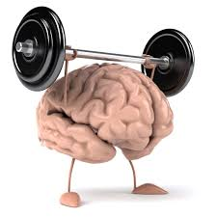
Using the information sheet, summarise the significance of pilgrimage for Hindus using these 3 specific examples – subheading each place of significance.
Stretch:Can you link in any key Hindu teachings and beliefs?
Notes:
the Kashi Vishwanath Mandir - dedicated to Lord Shiva
the Durga Temple - dedicated to the goddess Durga
the Tulsi Manas Temple - dedicated to Lord Rama
At this point, question students about the reasons Hindus make pilgrimage.
Pilgrimage is an important aspect of Hinduism. It's an undertaking to see and be seen by the deity.
Why is the Ganges so important?
The river Ganges is the holiest river for Hindus.
Popular pilgrimage places are rivers, but temples, mountains, and other sacred sites in India are also destinations for pilgrimages, as sites where the gods may have appeared or become manifest in the world

Slide 5
LO: To understand the role of pilgrimage and the purposes and practices associated with pilgrimage for Hindus
Here are a number of reasons why pilgrimage is important along with some counter arguments.
With your partner, separate them and write them under either of two headings: supporting or rejecting the practice of pilgrimage.
Now, use these reasons to construct a balanced answer, evaluating the statement below:
“Pilgrimage should not be a priority”
Evaluate this statement showing you have considered both points of view.
Notes:
¨ Kumbh Mela, is a religious festival that is celebrated four times over the course of 12 years, at one of four sacred cities of India: Allahabad, Ujjain, Nasik and Haridwar.
¨ Hindus from all walks of life gather there for ritual bathing, believing that their sins will be washed away. The bathing is followed by spiritual purification and a ceremony which secures the blessings of the deity.
¨ During the 12 years, In Hindu mythology, it is said that a drop of immortal nectar was dropped at each of these locations as Gods and demons fought over the pot or Kumbh that held the nectar.
¨ Millions of Hindus travel to the Mela to bathe in the Ganga, believing their sins will be washed away and they will achieve salvation. For other visitors, the festival is a fascinating spectacle of size and eccentricity.

Slide 6
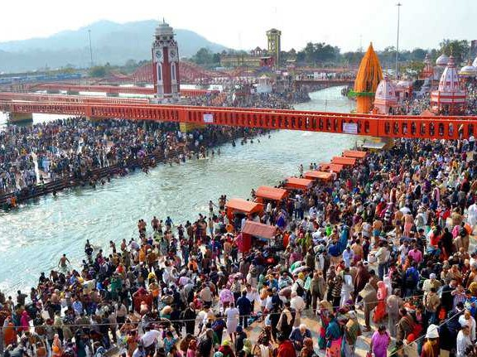
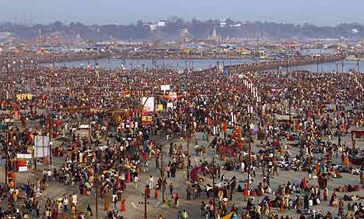
Kumbh Mela
Kumbh Mela, is a religious festival that is celebrated four times over the course of 12 years, at one of four sacred cities of India: Allahabad, Ujjain, Nasik and Haridwar.
Hindus from all walks of life gather there for ritual bathing, believing that their sins will be washed away. The bathing is followed by spiritual purification and a ceremony which secures the blessings of the deity.
During the 12 years, In Hindu mythology, it is said that a drop of immortal nectar was dropped at each of these locations as Gods and demons fought over the pot or Kumbh that held the nectar.
Millions of Hindus travel to the Mela to bathe in the Ganga, believing their sins will be washed away and they will achieve salvation. For other visitors, the festival is a fascinating spectacle of size and eccentricity.
Can a festival be a pilgrimage at the same time?
Notes:
EXTENSION TASK/ADDITIONAL TASK
¨ Kumbh Mela, s a religious festival that is celebrated four times over the course of 12 years, at one of four sacred cities of India: Allahabad, Ujjain, Nasik and Haridwar.
¨ Hindus from all walks of life gather there for ritual bathing, believing that their sins will be washed away. The bathing is followed by spiritual purification and a ceremony which secures the blessings of the deity.
¨ During the 12 years, In Hindu mythology, it is said that a drop of immortal nectar was dropped at each of these locations as Gods and demons fought over the pot or Kumbh that held the nectar.
¨ Millions of Hindus travel to the Mela to bathe in the Ganga, believing their sins will be washed away and they will achieve salvation. For other visitors, the festival is a fascinating spectacle of size and eccentricity.

Slide 7
Take 1 minute to sit quietly and reflect
What sort of sacrifices or challenges would you undertake in your own life to show your commitment or devotion to another person or cause?

